Slide 1
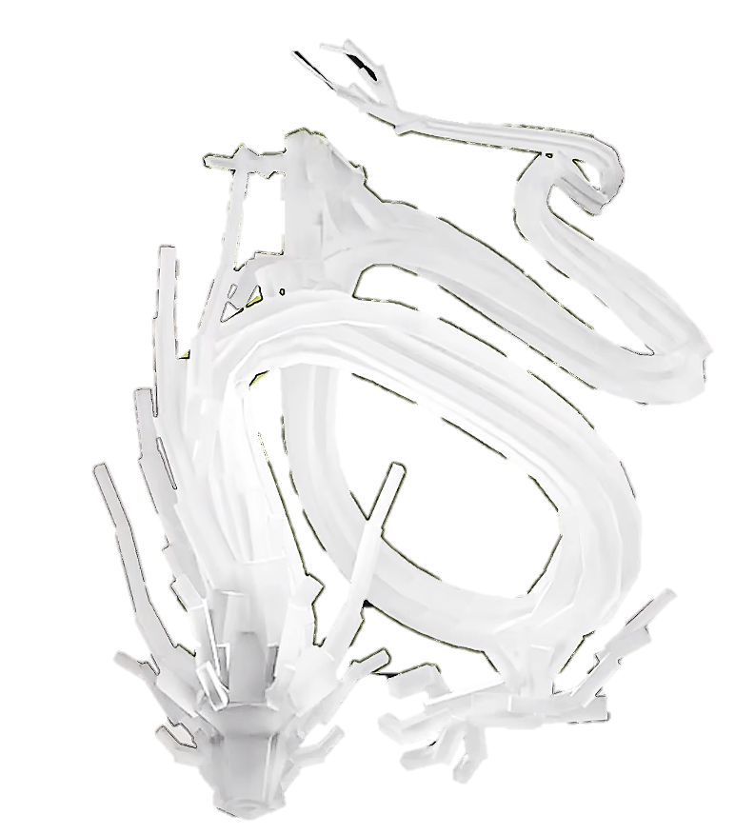


Traffic Flow Dynamic
Gong Ziyang

Slide 2

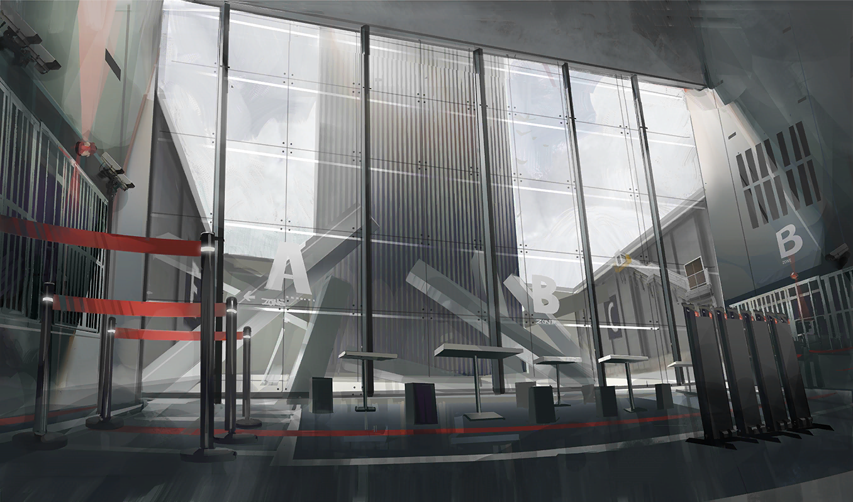
rhodeskesi
Chapt10. Elementary Car-Following Models
建议使用：带图小标题
可以修改右侧文字 介绍
英文字体：Novecento wide
中文字体：思源黑体

Slide 3
10.1 General Remarks
rhodeskesi
Complete models definition：
A car-following model is complete if it is able to describe all situations including acceleration and cruising in free traffic, following other vehicles in stationary and non-stationary situations, and approaching slow or standing vehicles, and red traffic lights.

Slide 4
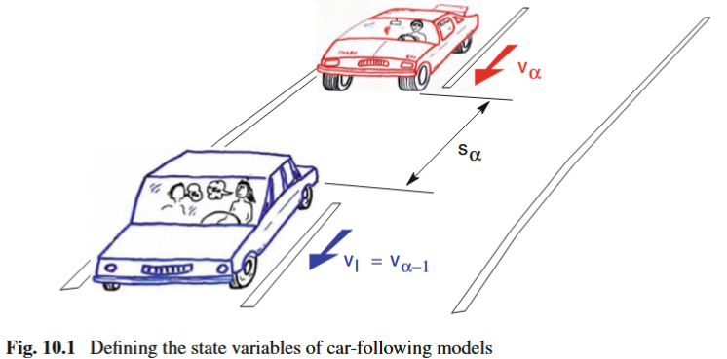
10.2 Mathematical Description
rhodeskesi
The vehicle index α such that vehicles pass a stationary detector in ascending orderthe first vehicle has the lowest index.
The acceleration of a following vehicle is determined by its current distance gap, its own speed, and the relative speed with respect to the leading vehicle.

Slide 5
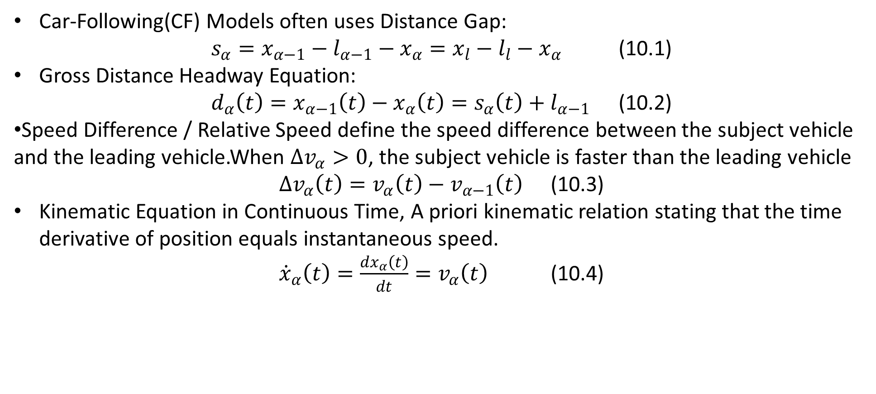
10.2 Mathematical Description
rhodeskesi
Car-Following(CF) Models often uses Distance Gap:
$s_{α}=x_{α−1}−l_{α−1}−x_{α}=x_{l}−l_{l}−x_{α}$ (10.1)
Gross Distance Headway Equation:
$d_{α}\left(t\right)=x_{α−1}\left(t\right)−x_{α}\left(t\right)=s_{α}\left(t\right)+l_{α−1}$ (10.2)
Speed Difference / Relative Speed define the speed difference between the subject vehicle and the leading vehicle.When $Δv_{α}>0$, the subject vehicle is faster than the leading vehicle
$Δv_{α}\left(t\right)=v_{α}\left(t\right)−v_{α−1}\left(t\right)$ (10.3)
Kinematic Equation in Continuous Time, A priori kinematic relation stating that the time derivative of position equals instantaneous speed.
${\dot{x}}_{α}\left(t\right)=\frac{dx_{α}\left(t\right)}{dt}=v_{α}\left(t\right)$ (10.4)

Slide 6
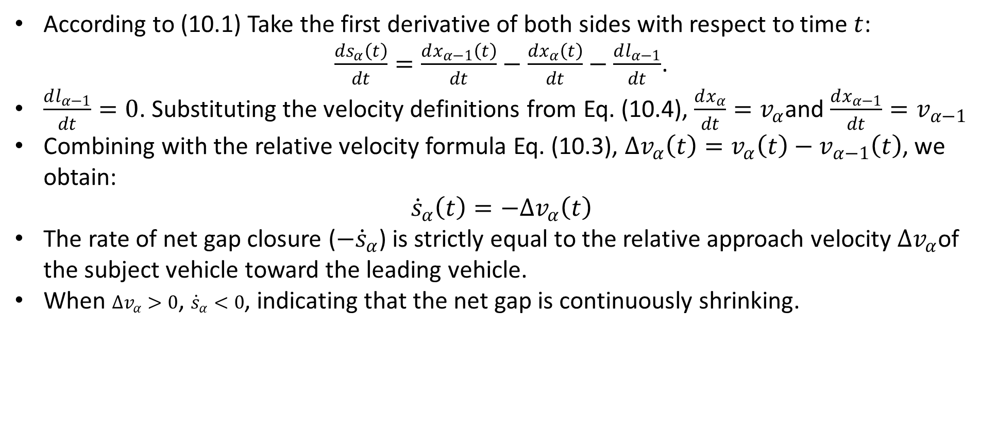
10.2 Mathematical Description
rhodeskesi
According to (10.1) Take the first derivative of both sides with respect to time $t$:
$\frac{ds_{α}\left(t\right)}{dt}=\frac{dx_{α−1}\left(t\right)}{dt}−\frac{dx_{α}\left(t\right)}{dt}−\frac{dl_{α−1}}{dt}$.
$\frac{dl_{α−1}}{dt}=0$. Substituting the velocity definitions from Eq. (10.4), $\frac{dx_{α}}{dt}=v_{α}$and $\frac{dx_{α−1}}{dt}=v_{α−1}$
Combining with the relative velocity formula Eq. (10.3), $Δv_{α}\left(t\right)=v_{α}\left(t\right)−v_{α−1}\left(t\right)$, we obtain:
$${\dot{s}}_{α}\left(t\right)=−Δv_{α}\left(t\right)$$
The rate of net gap closure ($−{\dot{s}}_{α}$) is strictly equal to the relative approach velocity $Δv_{α}$of the subject vehicle toward the leading vehicle.
When $Δv_{α}>0$, ${\dot{s}}_{α}<0$, indicating that the net gap is continuously shrinking.

Slide 7
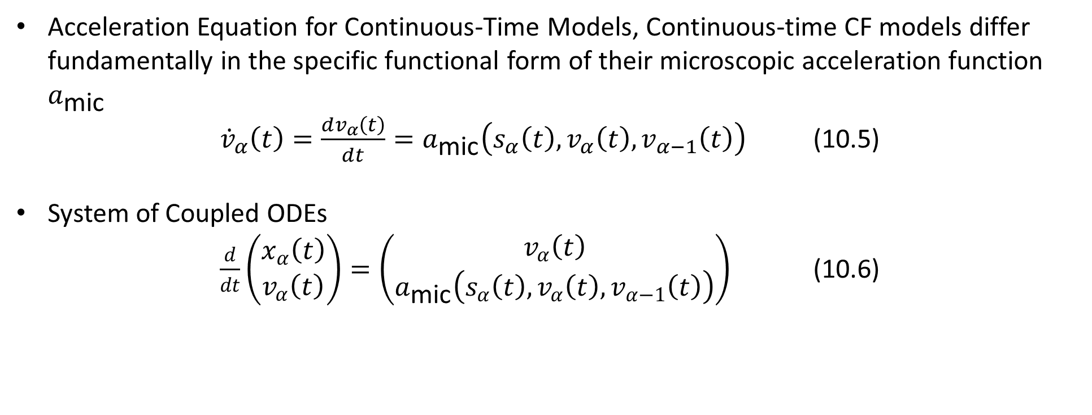
10.2 Mathematical Description
rhodeskesi
Acceleration Equation for Continuous-Time Models, Continuous-time CF models differ fundamentally in the specific functional form of their microscopic acceleration function $a_{\text{mic}}$
${\dot{v}}_{α}\left(t\right)=\frac{dv_{α}\left(t\right)}{dt}=a_{\text{mic}}\left(s_{α}\left(t\right),v_{α}\left(t\right),v_{α−1}\left(t\right)\right)$ (10.5)
System of Coupled ODEs
$\frac{d}{dt}\left(\begin{matrix}x_{α}\left(t\right) \\ v_{α}\left(t\right)\end{matrix}\right)=\left(\begin{matrix}v_{α}\left(t\right) \\ a_{\text{mic}}\left(s_{α}\left(t\right),v_{α}\left(t\right),v_{α−1}\left(t\right)\right)\end{matrix}\right)$ (10.6)

Slide 8
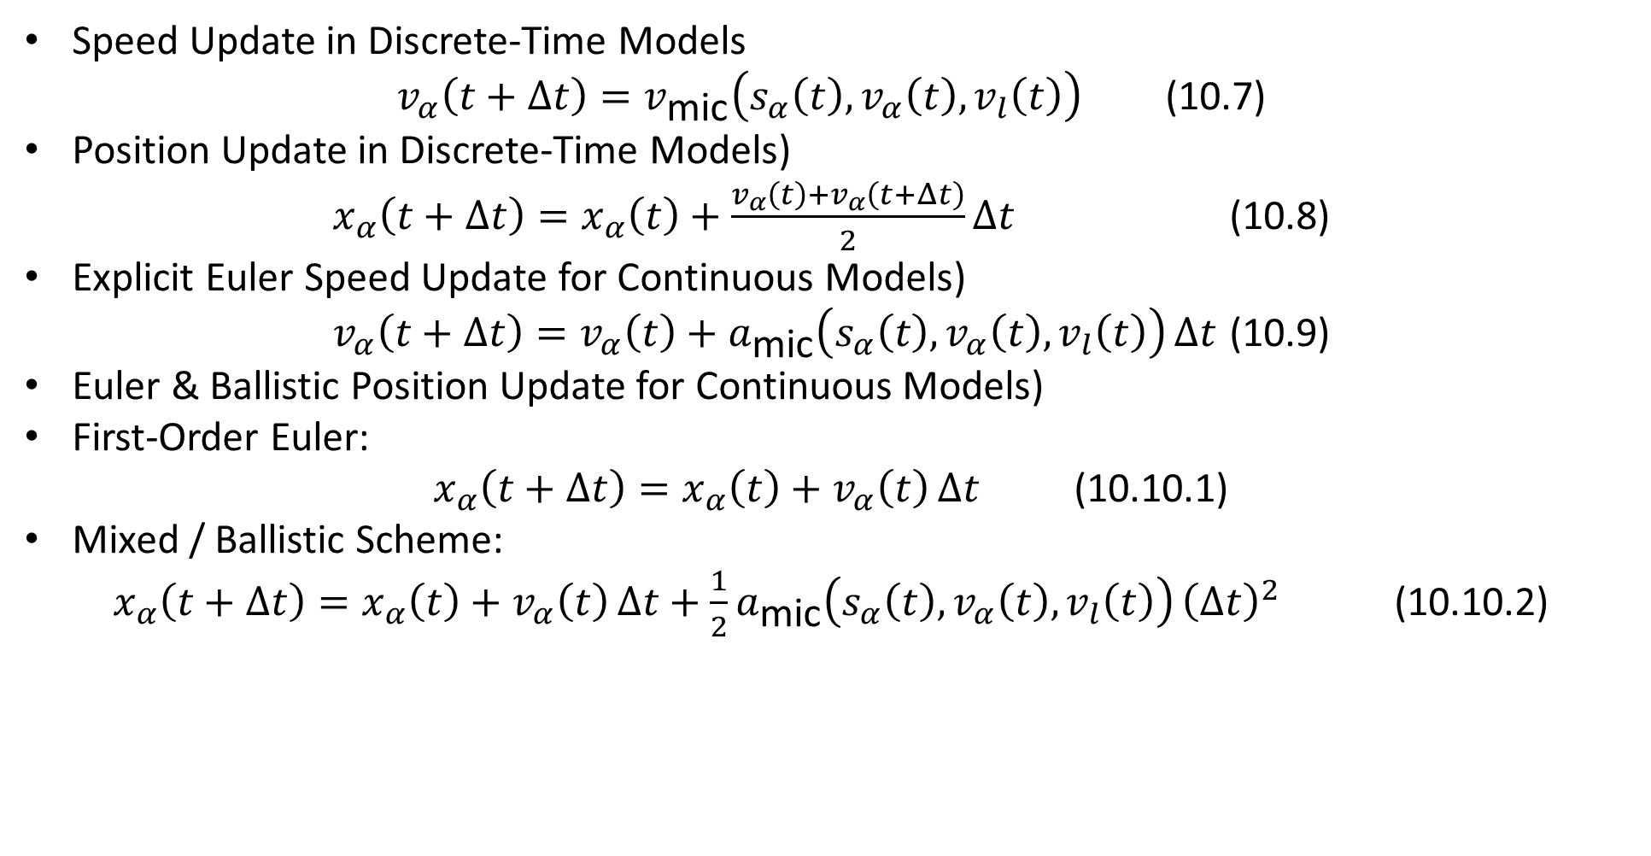
10.2 Mathematical Description
rhodeskesi
Speed Update in Discrete-Time Models
$v_{α}\left(t+Δt\right)=v_{\text{mic}}\left(s_{α}\left(t\right),v_{α}\left(t\right),v_{l}\left(t\right)\right)$ (10.7)
Position Update in Discrete-Time Models)
$x_{α}\left(t+Δt\right)=x_{α}\left(t\right)+\frac{v_{α}\left(t\right)+v_{α}\left(t+Δt\right)}{2}Δt$ (10.8)
Explicit Euler Speed Update for Continuous Models)
$v_{α}\left(t+Δt\right)=v_{α}\left(t\right)+a_{\text{mic}}\left(s_{α}\left(t\right),v_{α}\left(t\right),v_{l}\left(t\right)\right) Δt$ (10.9)
Euler & Ballistic Position Update for Continuous Models)
First-Order Euler:
$x_{α}\left(t+Δt\right)=x_{α}\left(t\right)+v_{α}\left(t\right) Δt$ (10.10.1)
Mixed / Ballistic Scheme:
$x_{α}\left(t+Δt\right)=x_{α}\left(t\right)+v_{α}\left(t\right) Δt+\frac{1}{2}a_{\text{mic}}\left(s_{α}\left(t\right),v_{α}\left(t\right),v_{l}\left(t\right)\right) {\left(Δt\right)}^{2}$ (10.10.2)

Slide 9
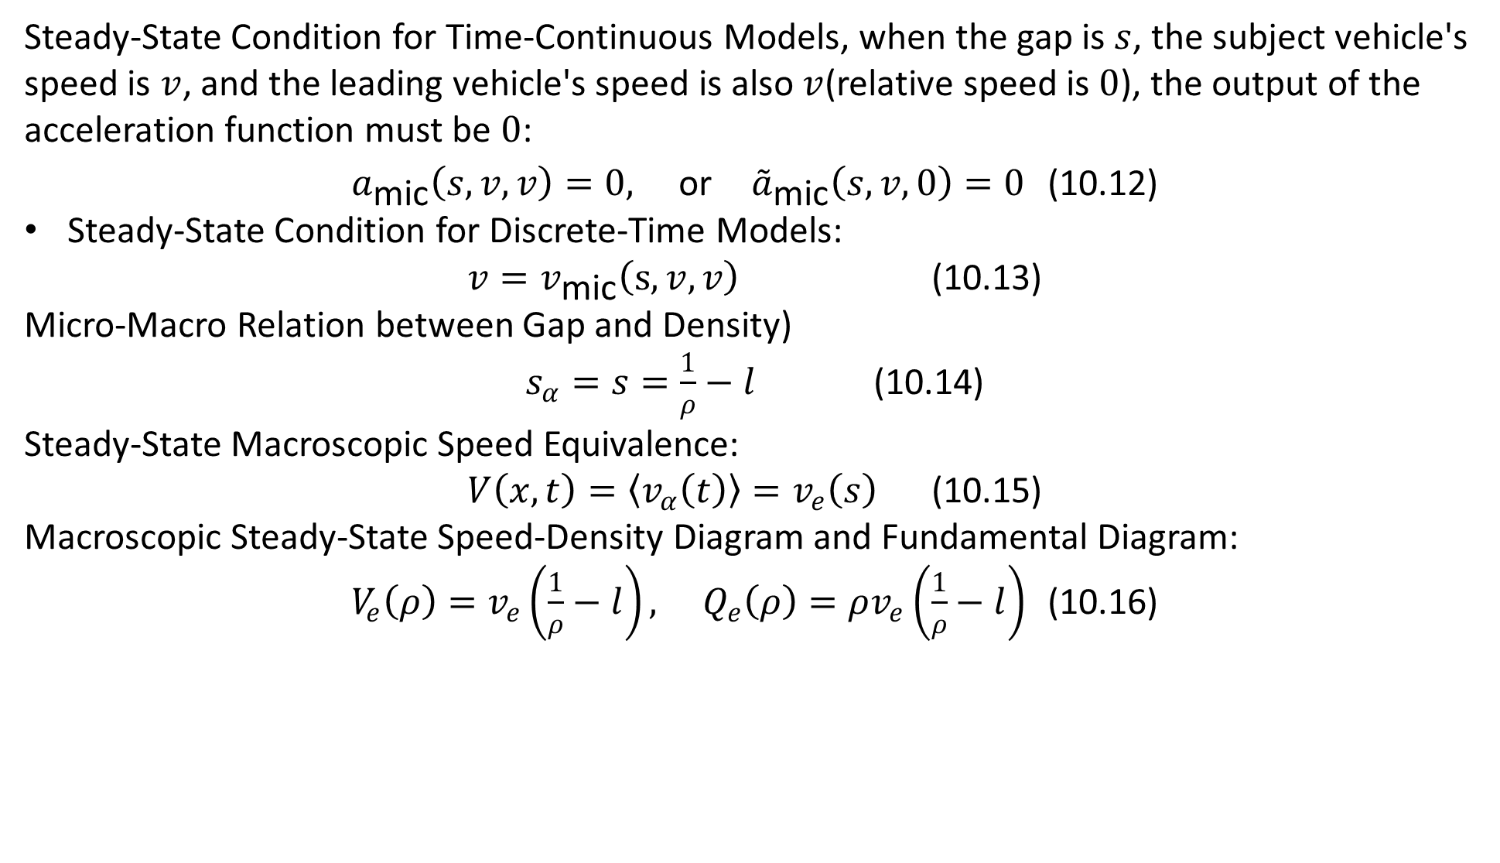
10.3 Steady State Equilibrium
rhodeskesi
Steady-State Condition for Time-Continuous Models, when the gap is $s$, the subject vehicle's speed is $v$, and the leading vehicle's speed is also $v$(relative speed is $0$), the output of the acceleration function must be $0$:
$a_{\text{mic}}\left(s,v,v\right)=0, \text{or} {\overset{˜}{a}}_{\text{mic}}\left(s,v,0\right)=0$ (10.12)
Steady-State Condition for Discrete-Time Models:
$v=v_{\text{mic}}\left(s,v,v\right)$ (10.13)
Micro-Macro Relation between Gap and Density)
$s_{α}=s=\frac{1}{ρ}−l$ (10.14)
Steady-State Macroscopic Speed Equivalence:
$V\left(x,t\right)=\left\langle v_{α}\left(t\right)\right\rangle =v_{e}\left(s\right)$ (10.15)
Macroscopic Steady-State Speed-Density Diagram and Fundamental Diagram:
$V_{e}\left(ρ\right)=v_{e}\left(\frac{1}{ρ}−l\right), Q_{e}\left(ρ\right)=ρv_{e}\left(\frac{1}{ρ}−l\right)$ (10.16)

Slide 10
10.4 Heterogeneous Traffic
rhodeskesi
Two Ways to Model Heterogeneous Traffic:
Same Model with Different Parameter Values:All driver-vehicle units are described by the same model using different parameter values.
Different parameter sets for different vehicle classes
Assigning parameters to each driver individually via statistical distributions.
Assigning different parameter distributions to different vehicle classes.
2. Different Models for Different Driver-Vehicle Classes: Different driver-vehicle classes can also be described with fundamentally different mathematical models. This allows us to directly represent qualitatively different driving characteristics.
ATTENTION:
Simulating heterogeneous traffic is only sensible in the context of multi-lane traffic models.
When parameterizing heterogeneous traffic, it is favorable if the model parameters have an intuitive meaning

Slide 11
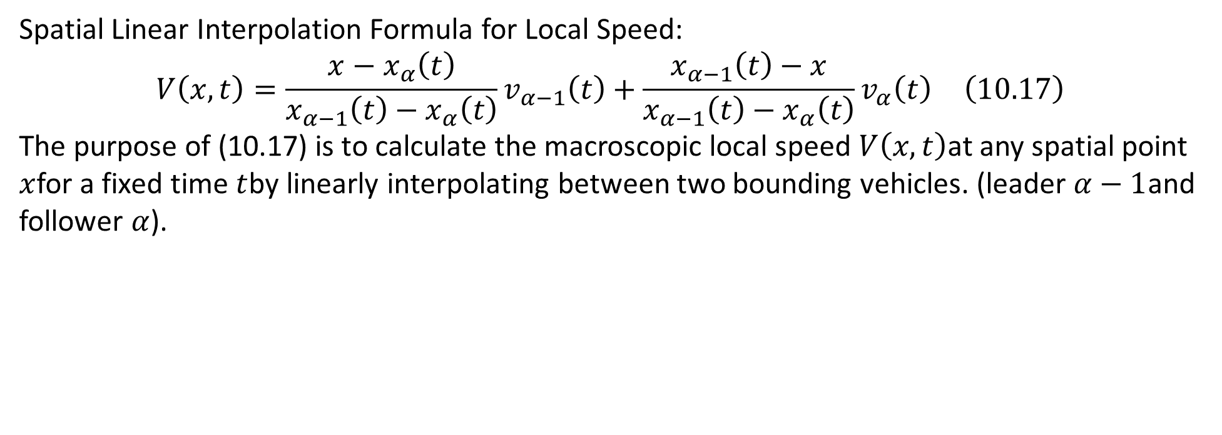
10.5 Fact Sheet of Dynamical Model Characteristics
rhodeskesi
Spatial Linear Interpolation Formula for Local Speed:
$$V\left(x,t\right)=\frac{x−x_{α}\left(t\right)}{x_{α−1}\left(t\right)−x_{α}\left(t\right)}v_{α−1}\left(t\right)+\frac{x_{α−1}\left(t\right)−x}{x_{α−1}\left(t\right)−x_{α}\left(t\right)}v_{α}\left(t\right) \left(10.17\right)$$
The purpose of (10.17) is to calculate the macroscopic local speed $V\left(x,t\right)$at any spatial point $x$for a fixed time $t$by linearly interpolating between two bounding vehicles. (leader $α−1$and follower $α$).

Slide 12
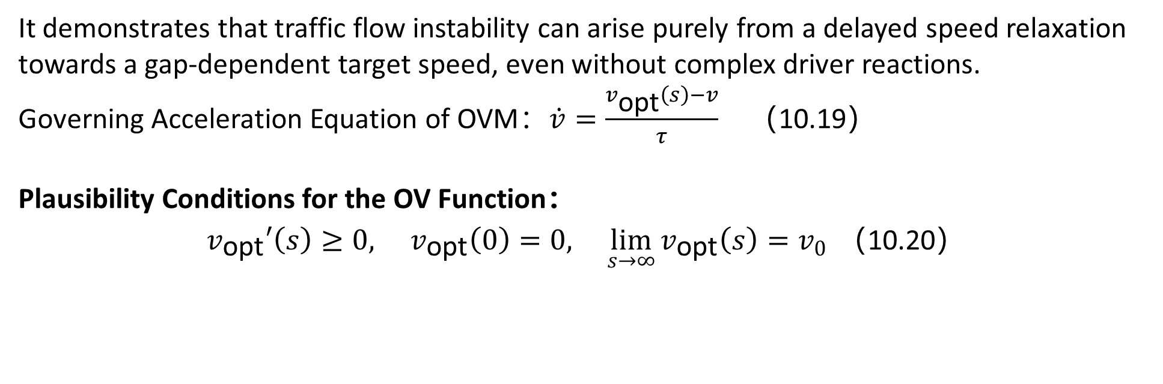
10.6 Optimal Velocity Model(OVM)
rhodeskesi
It demonstrates that traffic flow instability can arise purely from a delayed speed relaxation towards a gap-dependent target speed, even without complex driver reactions.
Governing Acceleration Equation of OVM：$\dot{v}=\frac{v_{\text{opt}}\left(s\right)−v}{τ}$（10.19）
Plausibility Conditions for the OV Function：
$v_{\text{opt}}′\left(s\right)≥0, v_{\text{opt}}\left(0\right)=0, \lim_{s→∞}{v_{\text{opt}}\left(s\right)}=v_{0}$ （10.20）

Slide 13
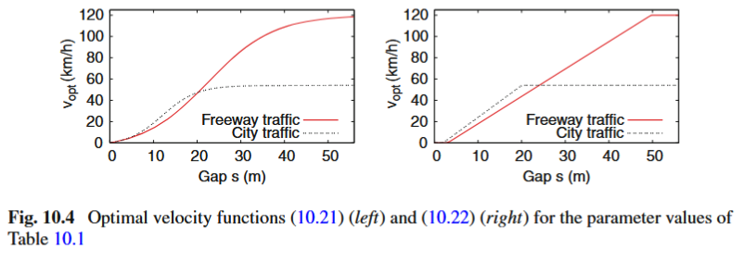
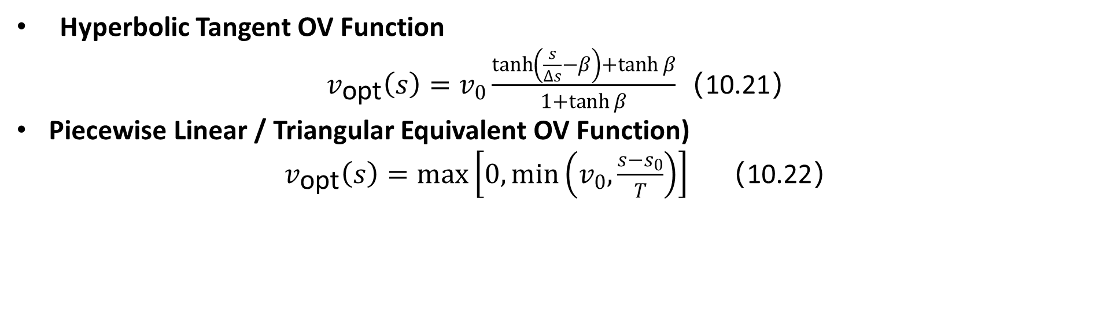
10.6 Optimal Velocity Model(OVM)
rhodeskesi
Hyperbolic Tangent OV Function
$v_{\text{opt}}\left(s\right)=v_{0}\frac{\tanh\left(\frac{s}{Δs}−β\right)+\tanh{β}}{1+\tanh{β}}$（10.21）
Piecewise Linear / Triangular Equivalent OV Function)
$v_{\text{opt}}\left(s\right)=\max\left[0,\min\left(v_{0},\frac{s−s_{0}}{T}\right)\right]$ （10.22）

Slide 14
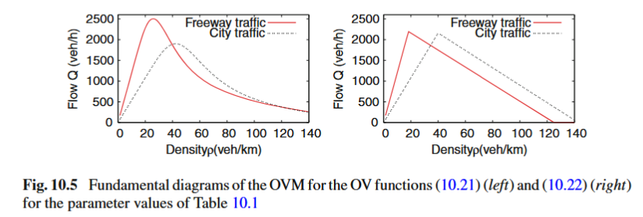
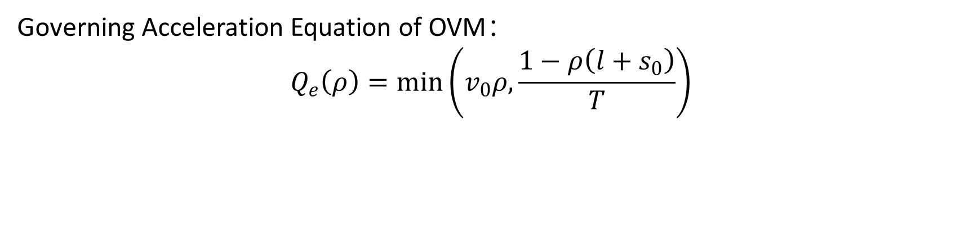
10.6 Optimal Velocity Model(OVM)
rhodeskesi
Governing Acceleration Equation of OVM：
$$Q_{e}\left(ρ\right)=\min\left(v_{0}ρ,\frac{1−ρ\left(l+s_{0}\right)}{T}\right)$$

Slide 15
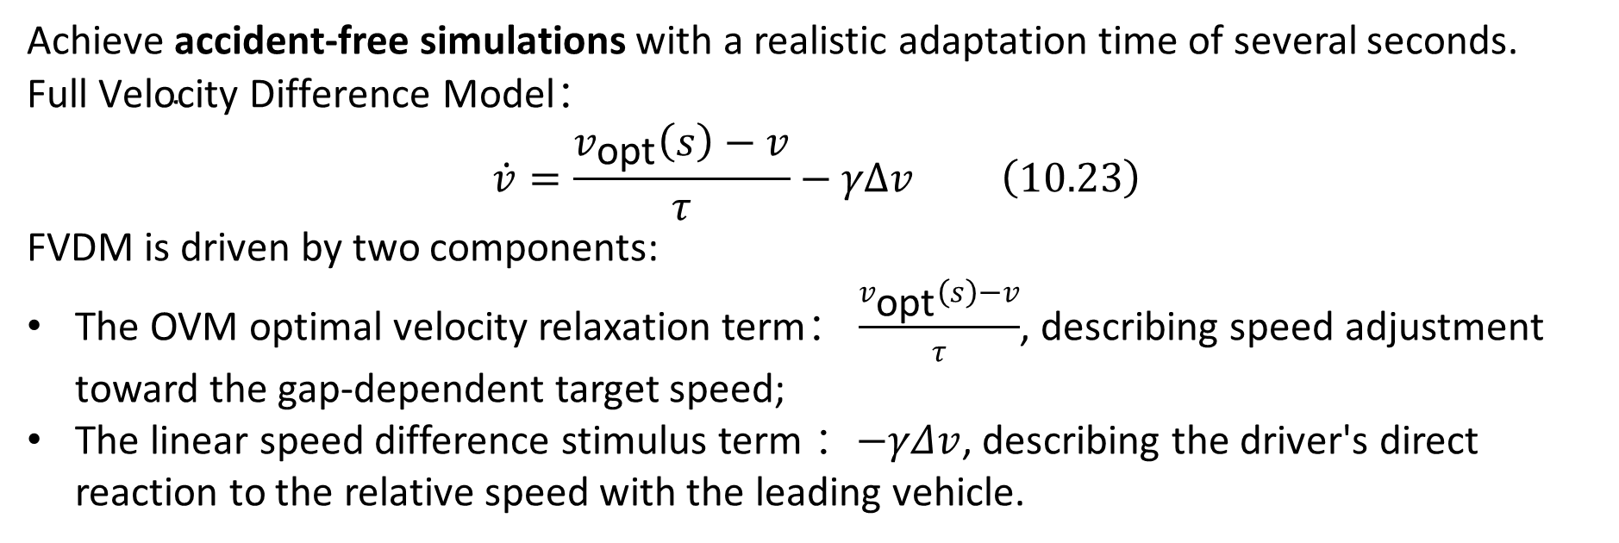
10.7 Full Velocity Difference Model（FVDM）
rhodeskesi
Achieve accident-free simulations with a realistic adaptation time of several seconds.
$$\text{Full} \text{Velocity} \text{Difference} \text{Model}：$$
$$\dot{v}=\frac{v_{\text{opt}}\left(s\right)−v}{τ}−γΔv \left(10.23\right)$$
FVDM is driven by two components:
The OVM optimal velocity relaxation term： $\frac{v_{\text{opt}}\left(s\right)−v}{τ}$, describing speed adjustment toward the gap-dependent target speed;
The linear speed difference stimulus term ：$−γΔv$, describing the driver's direct reaction to the relative speed with the leading vehicle.

Slide 16
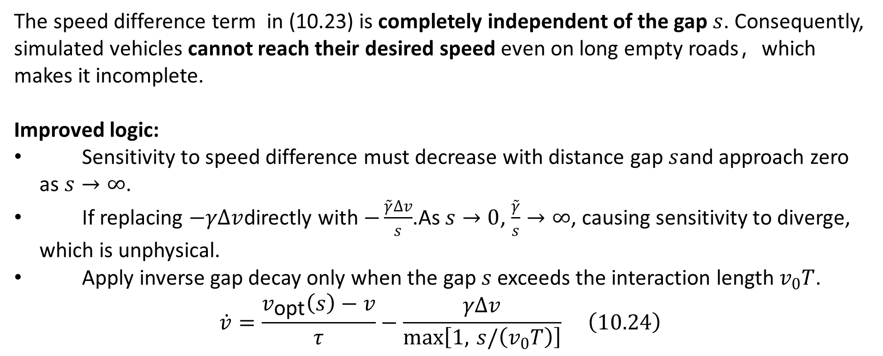
10.7 Full Velocity Difference Model（FVDM）
rhodeskesi
The speed difference term in (10.23) is completely independent of the gap $s$. Consequently, simulated vehicles cannot reach their desired speed even on long empty roads，which makes it incomplete.
Improved logic:
Sensitivity to speed difference must decrease with distance gap $s$and approach zero as $s→∞$.
If replacing $−γΔv$directly with $−\frac{\overset{˜}{γ}Δv}{s}$.As $s→0$, $\frac{\overset{˜}{γ}}{s}→∞$, causing sensitivity to diverge, which is unphysical.
Apply inverse gap decay only when the gap $s$ exceeds the interaction length $v_{0}T$.
$$\dot{v}=\frac{v_{\text{opt}}\left(s\right)−v}{τ}−\frac{γΔv}{\max\left[1, s/\left(v_{0}T\right)\right]} \left(10.24\right)$$

Slide 17
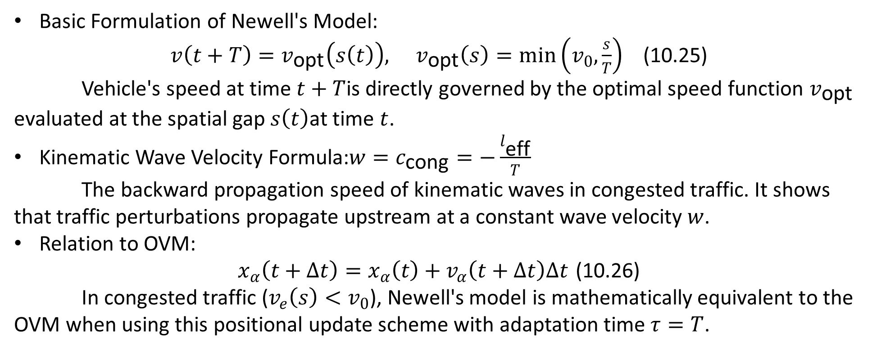
10.8 Newell’s Car-Following Model
rhodeskesi
Basic Formulation of Newell's Model:
$v\left(t+T\right)=v_{\text{opt}}\left(s\left(t\right)\right), v_{\text{opt}}\left(s\right)=\min\left(v_{0},\frac{s}{T}\right)$ (10.25)
Vehicle's speed at time $t+T$is directly governed by the optimal speed function $v_{\text{opt}}$ evaluated at the spatial gap $s\left(t\right)$at time $t$.
Kinematic Wave Velocity Formula:$w=c_{\text{cong}}=−\frac{l_{\text{eff}}}{T}$
The backward propagation speed of kinematic waves in congested traffic. It shows that traffic perturbations propagate upstream at a constant wave velocity $w$.
Relation to OVM:
$x_{α}\left(t+Δt\right)=x_{α}\left(t\right)+v_{α}\left(t+Δt\right)Δt$ (10.26)
In congested traffic ($v_{e}\left(s\right)<v_{0}$), Newell's model is mathematically equivalent to the OVM when using this positional update scheme with adaptation time $τ=T$.

Slide 18
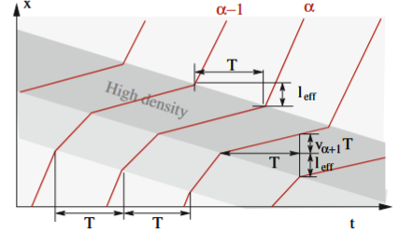
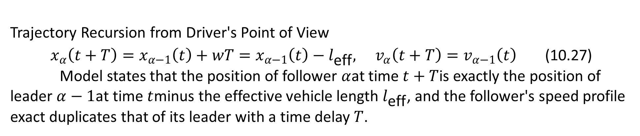
10.8 Newell’s Car-Following Model
rhodeskesi
Trajectory Recursion from Driver's Point of View
$x_{α}\left(t+T\right)=x_{α−1}\left(t\right)+wT=x_{α−1}\left(t\right)−l_{\text{eff}}, v_{α}\left(t+T\right)=v_{α−1}\left(t\right)$ (10.27)
Model states that the position of follower $α$at time $t+T$is exactly the position of leader $α−1$at time $t$minus the effective vehicle length $l_{\text{eff}}$, and the follower's speed profile exact duplicates that of its leader with a time delay $T$.

Slide 19
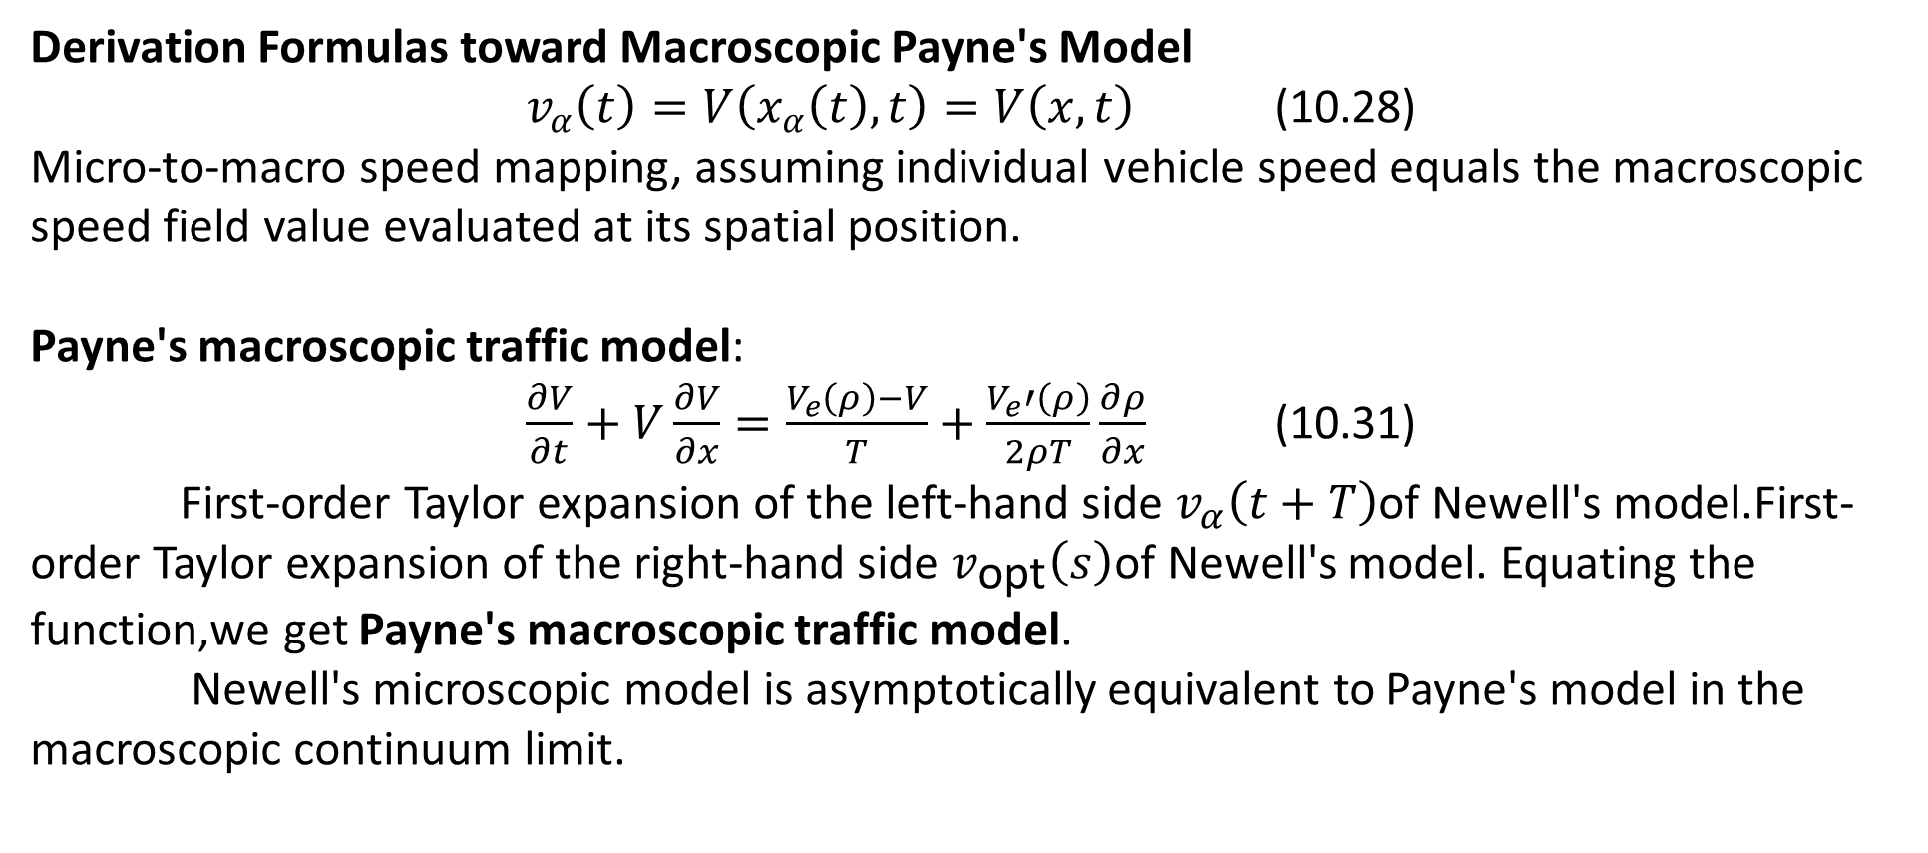
10.8 Newell’s Car-Following Model
rhodeskesi
Derivation Formulas toward Macroscopic Payne's Model
$v_{α}\left(t\right)=V\left(x_{α}\left(t\right),t\right)=V\left(x,t\right)$ (10.28)
Micro-to-macro speed mapping, assuming individual vehicle speed equals the macroscopic speed field value evaluated at its spatial position.
Payne's macroscopic traffic model:
$\frac{∂V}{∂t}+V\frac{∂V}{∂x}=\frac{V_{e}\left(ρ\right)−V}{T}+\frac{V_{e}′\left(ρ\right)}{2ρT}\frac{∂ρ}{∂x}$ (10.31)
First-order Taylor expansion of the left-hand side $v_{α}\left(t+T\right)$of Newell's model.First-order Taylor expansion of the right-hand side $v_{\text{opt}}\left(s\right)$of Newell's model. Equating the function,we get Payne's macroscopic traffic model.
Newell's microscopic model is asymptotically equivalent to Payne's model in the macroscopic continuum limit.

Slide 20
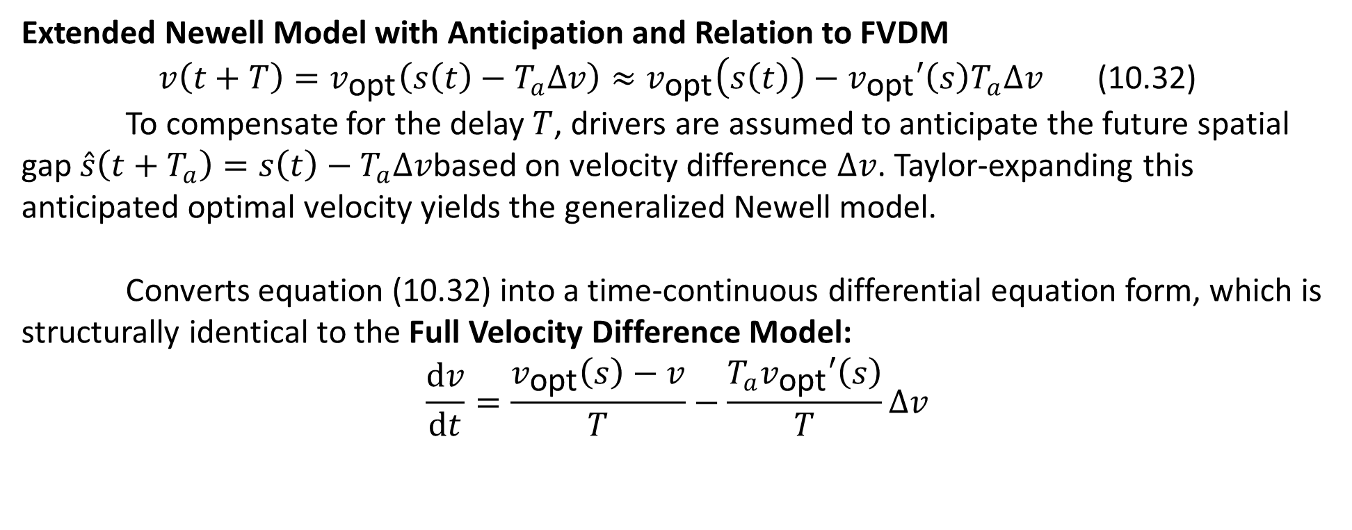
10.8 Newell’s Car-Following Model
rhodeskesi
Extended Newell Model with Anticipation and Relation to FVDM
$v\left(t+T\right)=v_{\text{opt}}\left(s\left(t\right)−T_{a}Δv\right)≈v_{\text{opt}}\left(s\left(t\right)\right)−v_{\text{opt}}′\left(s\right)T_{a}Δv$ (10.32)
To compensate for the delay $T$, drivers are assumed to anticipate the future spatial gap $\overset{ˆ}{s}\left(t+T_{a}\right)=s\left(t\right)−T_{a}Δv$based on velocity difference $Δv$. Taylor-expanding this anticipated optimal velocity yields the generalized Newell model.
Converts equation (10.32) into a time-continuous differential equation form, which is structurally identical to the Full Velocity Difference Model:
$$\frac{dv}{dt}=\frac{v_{\text{opt}}\left(s\right)−v}{T}−\frac{T_{a}v_{\text{opt}}′\left(s\right)}{T}Δv$$

